Slide 1
Path to Deep Learning

Slide 2

Topics to be Covered….
Introduction to Neural Networks
Activation Functions used in Neural Networks
Optimizers used in Neural Networks
The Dropout Layer for Neural Networks
Hyper Parameter Tuning in Neural Networks
Batch Normalization in Neural Networks
Implementation of Neural Networks

Slide 3
Introduction to Neural Networks

Slide 4
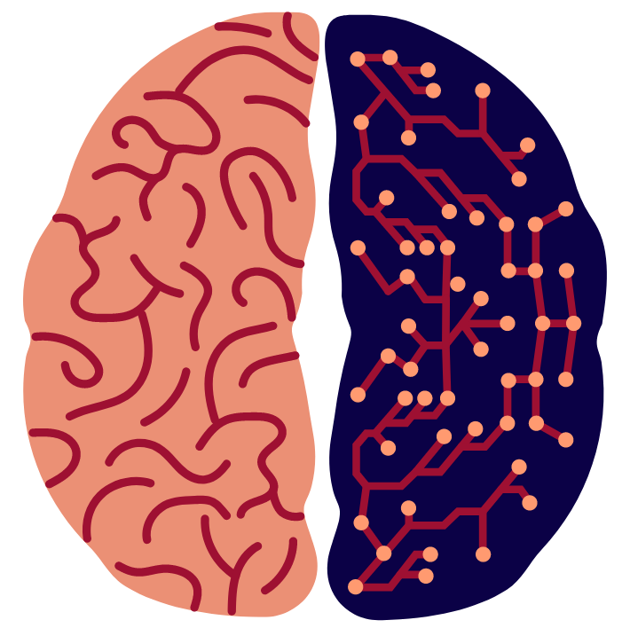
What is a Neural Network?
A neural network is a series of algorithms that helps us to recognize relationships in a dataset through a process which mimics the way Human brain works.
It can adapt to Changing Input and generate the Best Results for us.

Slide 5
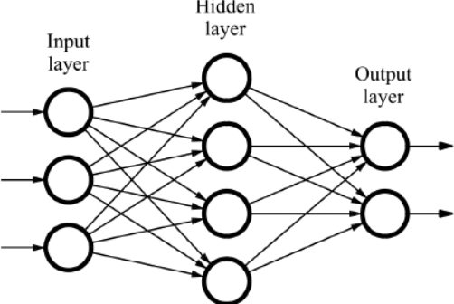
What are the Components of a Neural Network?
There are 3 Major Components in a Neural Network:
The Input Layer
The Hidden Layer
The Output Layer

Slide 6
Introduction to Activation Functions

Slide 7
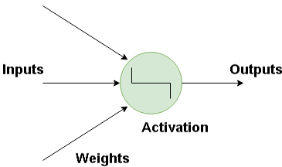
What is an Activation Function?
Activation functions are mathematical equations that determine the output of a neural network.
It help us to determine the output of the program by normalizing the output values in a range of 0 to 1 or -1 to 1.

Slide 8
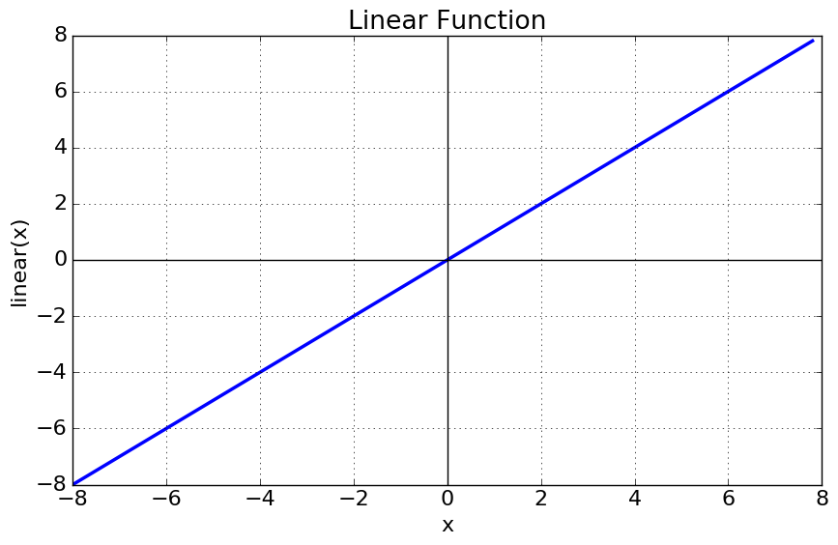
Types of Activation Function
Linear Activation Function
The Equation for this line would be f(x) = x, and the range would be from -infinity to +infinity.

Slide 9
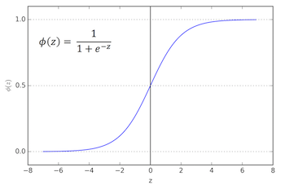
Types of Activation Function
Non Linear Activation Function
These Nonlinear Functions makes it easy for the model to generalize or adapt with a variety of data and to differentiate between the output.

Slide 10
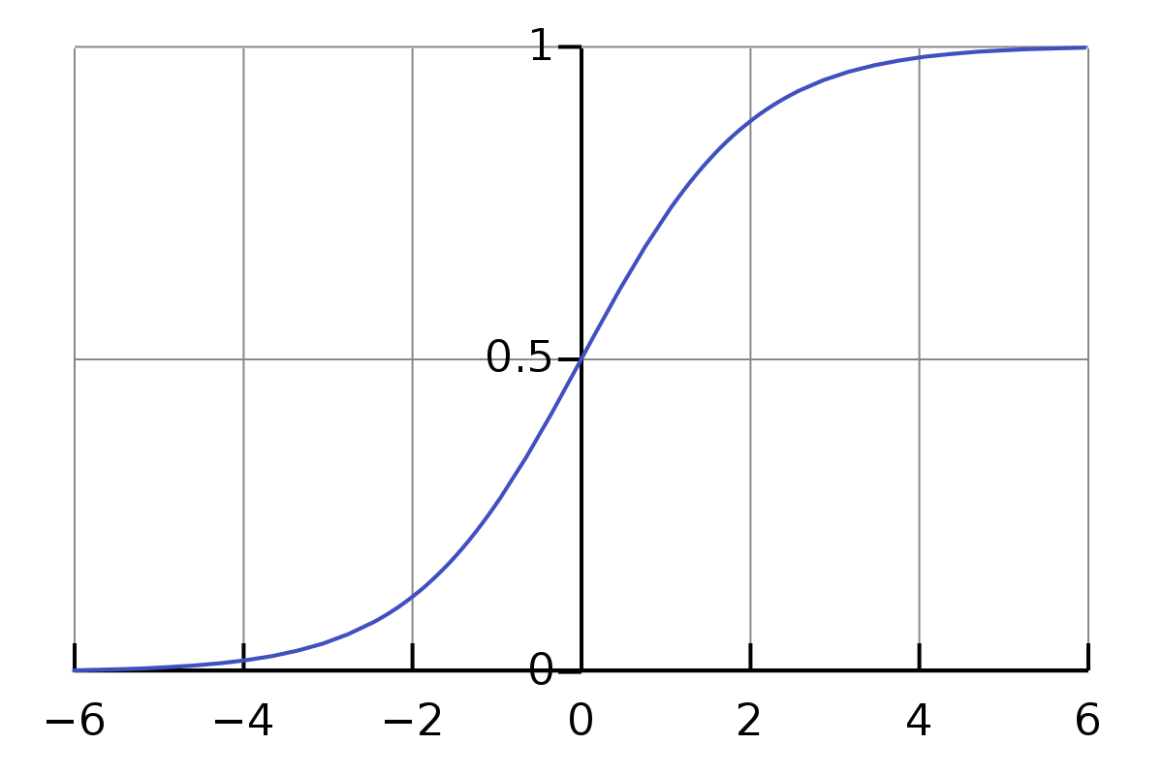
Sigmoid Activation Function
A sigmoid function is a mathematical function having a characteristic "S"-shaped curve or sigmoid curve.
The Main reason behind using the Sigmoid function is that this function exists between 0 to 1.

Slide 11
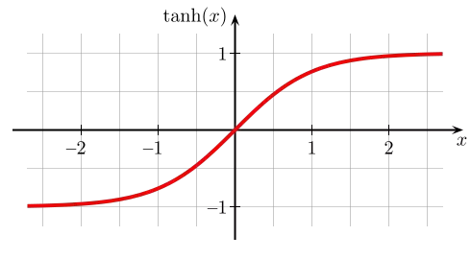
Tanh Activation Function
The Range of the tanh Function is -1 to +1 as you can see in the Graph.
Tanh activation has large area under better slope compared to sigmoid, this helps models using Tanh activation to learn better.

Slide 12
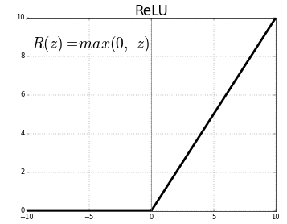
Relu Activation Function
It is also known as Rectified Linear Unit Activation function.
It is half rectified from bottom, which means If you feed any negative data to Relu, It will return you a Zero, and If you feed any positive data, It will return you the exact number

Slide 13
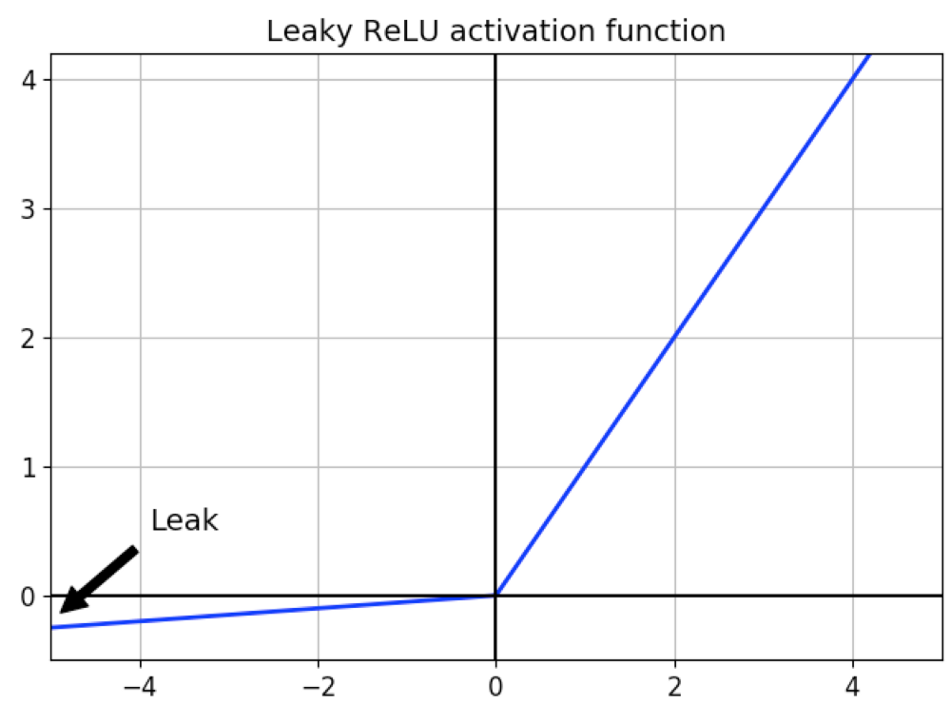
Leaky Relu Activation Function
Any negative input given to ReLU turns the value into zero which in turns affects the resulting graph by not mapping the negative values appropriately.
This is the reason Relu was reintroduced with a Leak to Increase the Range of Learning.

Slide 14

Softmax Activation
The formula for Softmax Activation is : -

Slide 15
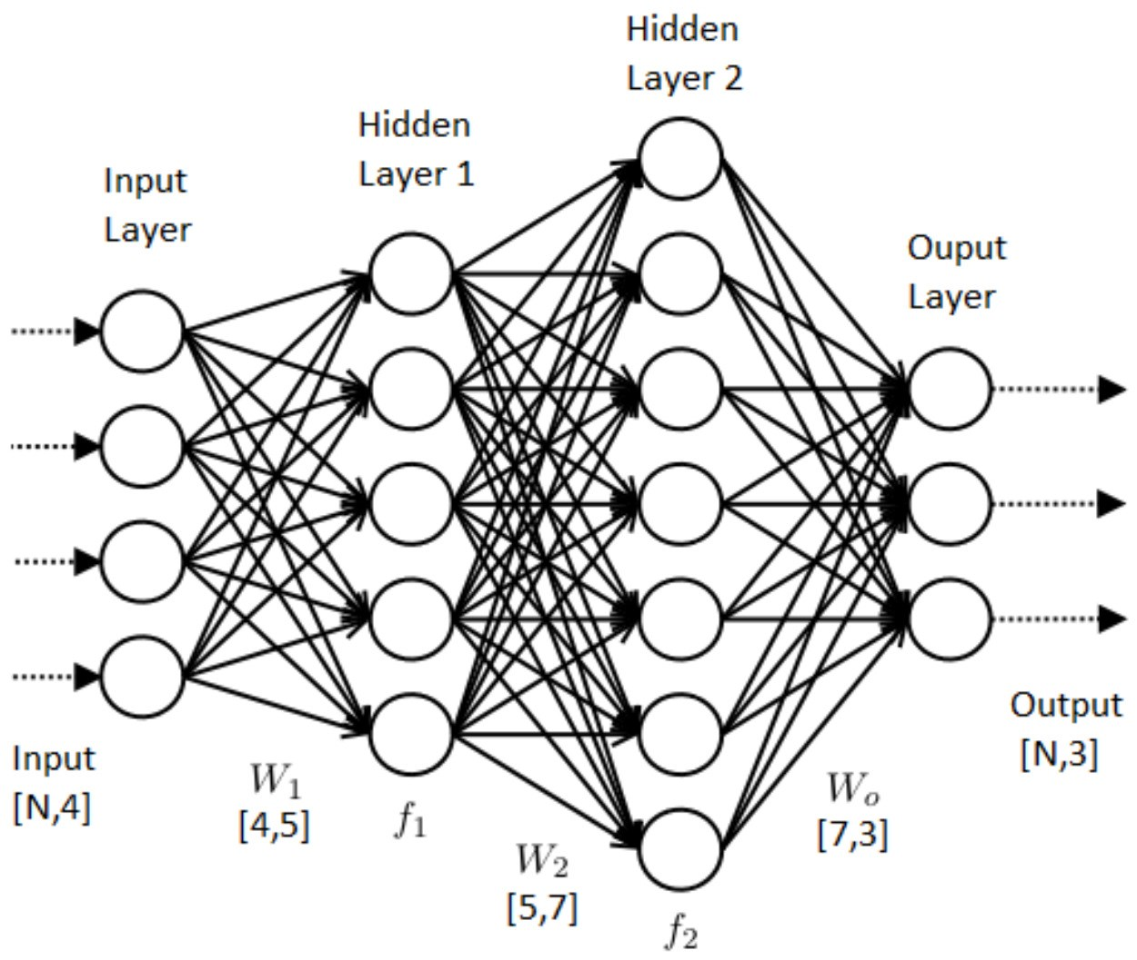

Slide 16
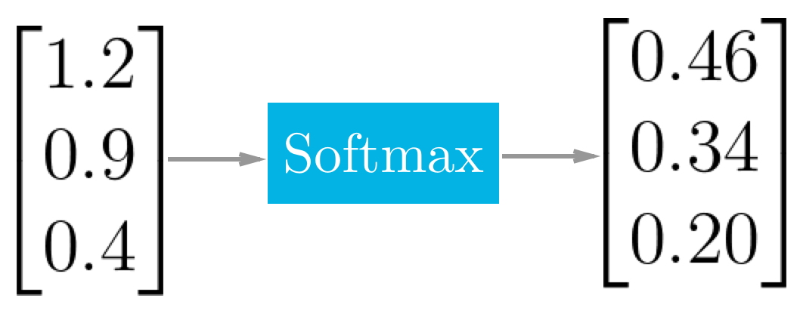
Apple
Banana
Orange
The Total Sum of Probabilities is 1, and as Apple has Highest Probability, The answer will be Apple.

Slide 17
Introduction to Gradient Descent

Slide 18
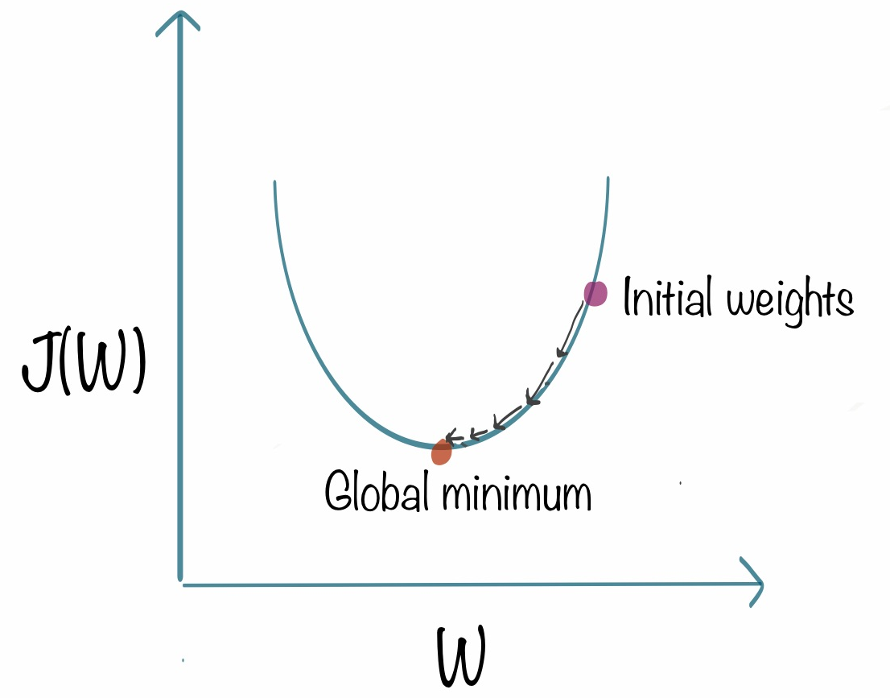
What is a Gradient Descent?
Gradient Descent also known as “Back propagation” is an optimization technique that is used to improve deep learning and neural network-based models by minimizing the loss function.

Slide 19
Loss Function
Loss function quantifies the amount of error in your predictions, It is a metric that is directly related to the performance of the model.
If Predictions are Good, then the Loss function would output a Lower Number and Vice Versa.
Our Loss Function should always Justify two things that is
It should always be low.
It should be differentiable.

Slide 20
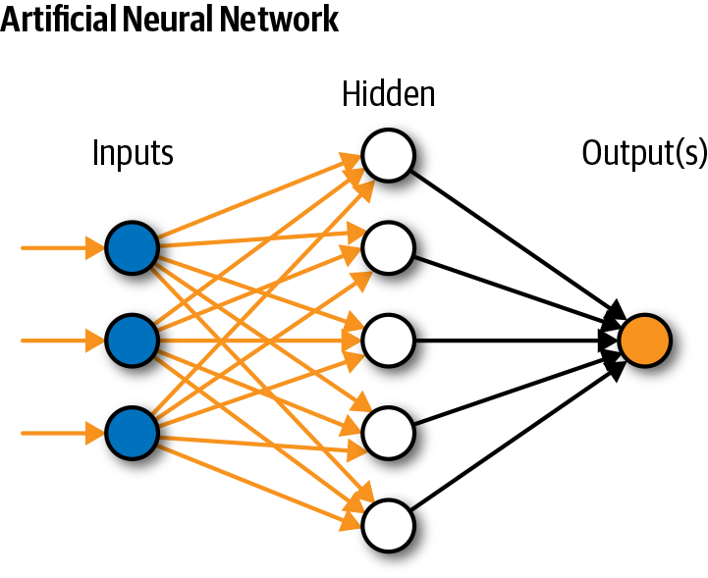
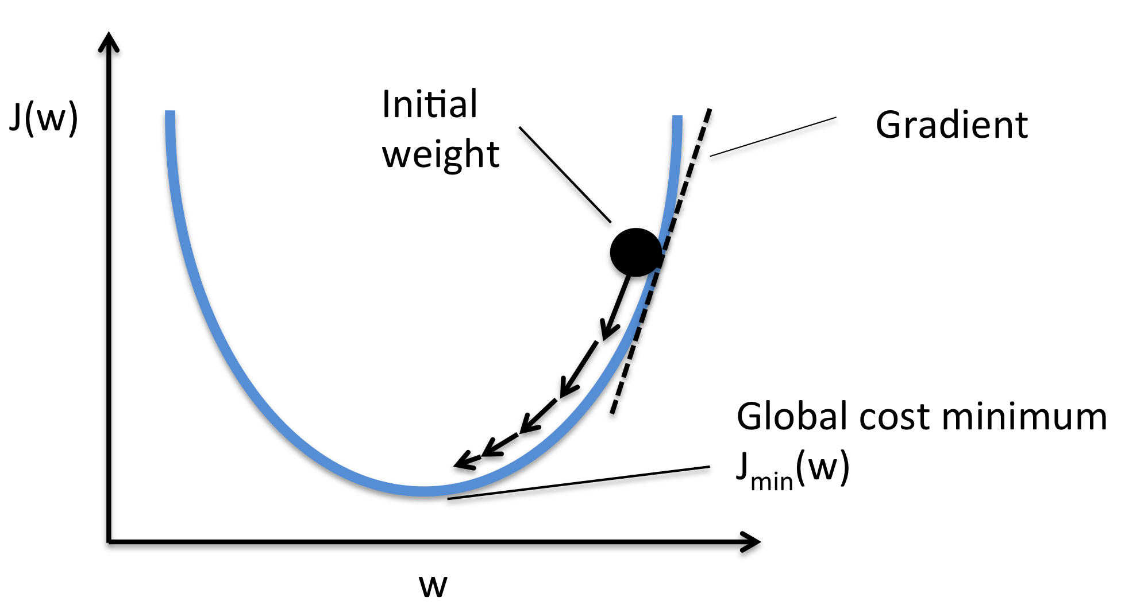
Artificial Neural Network
Initially, Our Neural Network has a High Loss,
Then slowly slowly Weights are Updated to Minimize the Loss.

Slide 21
Batch Gradient Descent
We take the whole Training Data as a batch and pass it to the network. The network calculates the Gradient for whole Training Data and Updates the weights.
Advantage: Speed
Disadvantage: Poor Learning in Initial Phases, High Memory Consumption.

Slide 22
Stochastic Gradient Descent
Here we take each data point and calculate its gradient.
Next we update weights and repeat this process.
So if our dataset has 1000 data points, using stochastic gradient descent we will calculate gradients and update weight 1000 times in one epoch.
Advantage: Low Memory Consumption
Disadvantage: Low Speed

Slide 23
Mini Batch Gradient Descent
Here we internally batch the training data, we then calculate gradient and update weights for each batch.
We repeat this process until gradients over whole training data is calculated and weights are updated.
So if our dataset has 1000 examples and our batch size is suppose 100, then we update weights 10 times for each epoch.
Advantage: Low Memory Consumption, High Speed

Slide 24
Introduction to Optimizers

Slide 25
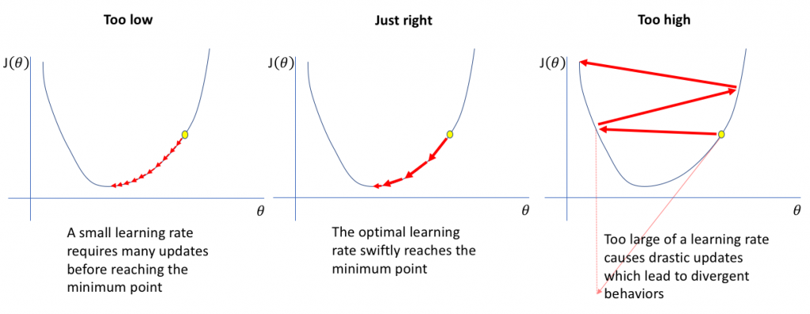
Why do we need Optimizers?

Slide 26
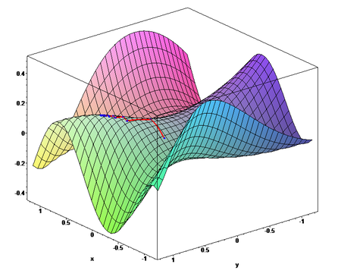
Loss vs Weight Curves in 3 Dimensions

Slide 27
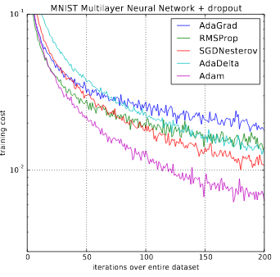
Optimizers in Tensorflow
Momentum
RMS Prop
Adagrad
AdaDelta
Adam
A chart that explains the loss to epochs comparison of different optimizers.
Adam Seems to be the Best One!

Slide 28
Why do we need Dropout

Slide 29
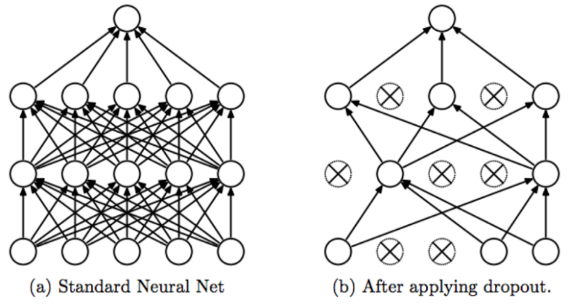
What is Dropout?
Dropout is an approach to Regularization in Neural Networks which helps in Independent Learning of the Neurons.
It is Highly effective in avoiding Overfitting

Slide 30
Common Observations While using Dropout for Avoiding Overfitting in Neural Networks
Dropout Forces the Neural Network to learn more Robust Features that are Useful for Predictive analytics.
Dropout Helps us to Reduce the Training Time required for the Neural Network.
Choosing the Right value for Dropout is crucial to get Good Results.

Slide 31
Values for Dropout
Values for Dropout Vary from 0 to 1.
If zero is specified, it means no dropout is required.
0.2 means 20% of all the Neurons from Hidden Layer is removed.
0.5 means 50% of all the Neurons are removed at random from the Specified Hidden Layer.

Slide 32
Hyperparameter Tuning

Slide 33
Tuning our Neural Networks
Important Parameters to be considered while tuning a Neural Network
Number of Layers in a Neural Network
The Dropout Value
Learning Rate of the Neural Network
The Batch Size

Slide 34
Choosing the Right Number of Hidden Layers in a Neural Network
Choose 3 to 5 Hidden Layers for a Medium Sized Dataset.
Neural Networks Might Suffer from Underfitting if the hidden layers are less than 2.
Similarly, the Neural Networks can suffer from Overfitting if the Number of Hidden layers are too high.
For Bigger Problems, Slowly Increase the Hidden Layers and Check see if Increasing Hidden Layers optimizes the Neural Network.

Slide 35
How to Choose the Right Value for Dropout in Neural Networks?
Most of the Times, the Value of 0.2 to 0.4 is the Most preferable for Dropout, which means deactivating 20 to 40% of the Neurons from the Hidden Layers.
Always Try to Maintain a Dropout Value lesser than 0.5, As Higher than 0.5 Value for Dropout can lead to Overfitting.
Dropout values Less than 0.2 Value will have no or Little Significance.

Slide 36
How to choose the Learning rate for the Neural Networks?
Optimizing the value of a Learning Rate is considered to be the Most Important step in Optimization of a Neural Network.
If the learning rate is low, then training is more reliable, but optimization will take a lot of time, and If the learning rate is high, then training may not converge or even diverge.
The Most common learning rates in Neural networks are 0.01 or 0.001.

Slide 37
How to select the Batch Size in Neural Networks?
Generally The Batch Size of 32 is Good, But we should also try the Batch Sizes of 64, 128, and 256.
If your problem statement is complex, having low batch size works better as low batch size and mini batch gradient descent we will have more weight updates which ensures our weights are better tuned.
If your problem statement is simple, then try to have the maximum batch size that can fit your memory.

Slide 38
Introduction to Batch Normalization

Slide 39
What is Batch Normalization?
Batch normalization is a technique for training very deep neural networks that standardizes the inputs to a layer for each mini-batch.
This has the effect of stabilizing the learning process and dramatically reducing the number of training epochs required to train deep networks.

Slide 40
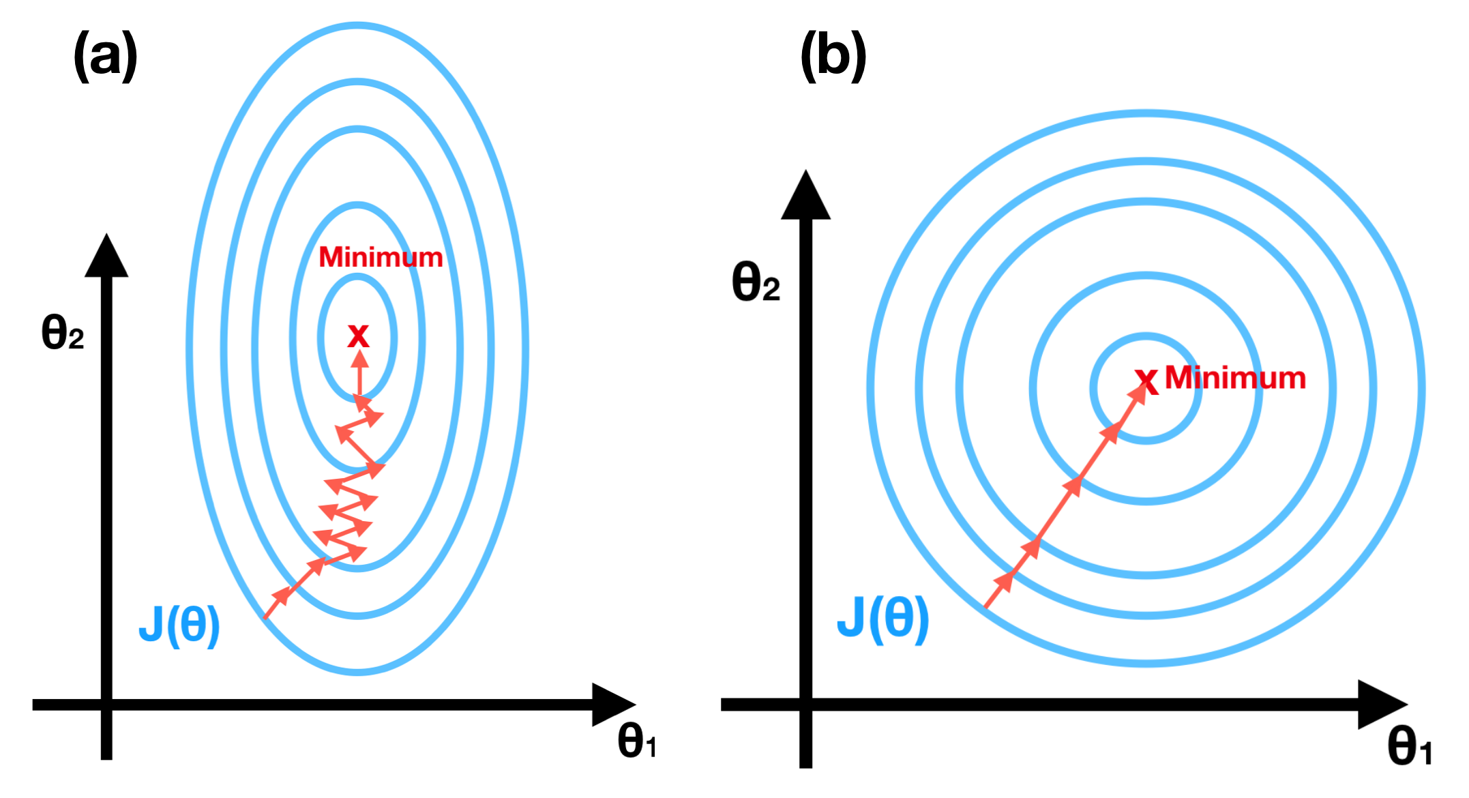
Here, the Features are Non-Normalized
As the Values of Both Age and Salary are not Normalized.
Here, the Features are Normalized.
As the Values of Both Age and Salary lie from 0 to 1.
On the left side we have a loss curve using Non normalized features,
On the right we have a loss curve with normalized features.
Let’s Suppose We have Two Features Age and Salary.
Their scales would be 1 to 100 and 10000 to a big number respectively.

Slide 41
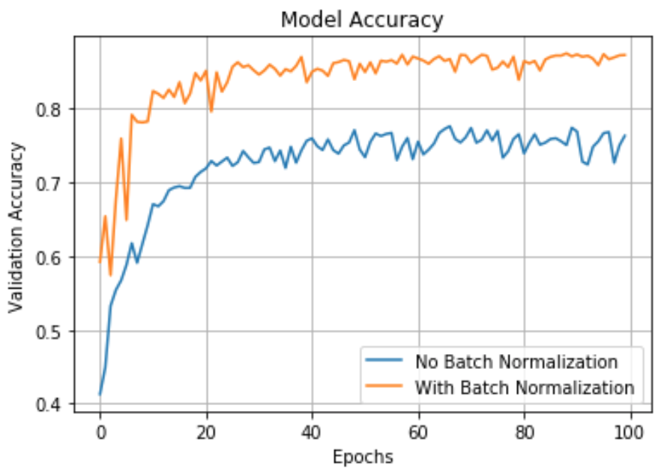
Advantages of Batch Normalization
Faster Training
Better Accuracy

